Slide 1
Quiz Dubai
November 2020

Slide 2


Slide 3

Basic Rules
26 questions
Infinite bounce + pounce
+10 on bounce (part points available)
+ 10 / - 10 on pounce
Pounce timer will run for 90 seconds for each question.
No need to announce you are pouncing – answer over Zoom.
Answer must be in within 90 seconds.
Questions are designed to be workable (we hope!) – so please guess ☺

Slide 4
Clockwise

Slide 5

1

Slide 6
Tchaikovsky’s Dance of the Sugar Plum Fairy (from the Nutcracker) owes a lot to an invention by Auguste Mustel with certain “heavenly” attributes. In the 1880s, Tchaikovsky acquired this invention, but kept it secret till the launch of The Nutcracker. Viewers were taken aback by the effect produced by Mustel’s invention. Even today, this effect remains synonymous with Dance of the Sugar Plum Fairy. What did Mustel invent / what is the effect it produced? (5) Performers fleeing the Russian Revolution carried The Nutcracker outside Russia, where it is now associated with the Christmas holidays, esp. in the U.S. This association stems from a change introduced by choreographer George Balanchine. The change meant longer training for The Nutcracker, leading to scheduling performances late in the year. It also meant that a certain demographic would be over-represented in the audience, and scheduling around Christmas holidays would be most convenient for them to attend. What change did Balanchine make? (5)
1

Slide 7
Answer is…

Slide 8

Mustel invented the musical instrument known as the celesta (or celeste or bell piano), which looks similar to an upright piano. Unlike a piano, however, the keys of the celesta connect to hammers that strike a graduated set of metal (usually steel) plates – giving the instrument its traditional metal bell sound, which is most closely associated with Dance of the Sugar Plum Fairy. The change that Balanchine made was casting children in all but the main roles for The Nutcracker. As a result, parents of performing children would want to attend the performances, and the most convenient time for this would be around the Christmas holidays.
1

Slide 9
William Dampier, an explorer and pirate, famously discovered a Pacific fruit – “when ripe it is yellow and soft; and the taste is delicious … the inside is soft, tender, and white, like the crumb of a pennyloaf.” This caught the attention of British sugar planters in the West Indies, who set sail to collect saplings of this tree, feeling the fruit might be ideal food supply on their small plots of land. What historical incident did the discovery of this fruit inadvertently lead to? (5) Dampier’s journal entries also precipitated the Darien scheme – an unsuccessful 1690s attempt by X to develop a colony (New Caledonia – no relation to current French territory) on the Isthmus of Panama, to offer an overland route connecting the oceans. The scheme was backed by the life savings of X’s citizens but was a complete disaster, since they didn’t anticipate opposition from other European powers. Humbled, they had to seek a bailout – which they received, but on punitive terms that continue to animate X’s politics to this day. Who bailed X out, and under what condition? (5)
2

Slide 10
Answer is…

Slide 11
The historical incident is The Mutiny on the HMS Bounty – the fruit that Dampier discovered was the breadfruit. Dampier’s writings served as the impetus for a British mission to bring a thousand potted breadfruit trees from the South Pacific around the Horn of Africa to the West Indies. With the ship retrofitted to shelter the saplings, the miserably crammed and mistreated crew mutinied. X = Scotland. Scotland, via the Company of Scotland, was the major financier for the effort. It failed in part because the EEIC & England instituted a blockade against merchants who traded with the Company of Scotland, and Spanish captured and imprisoned crew on the Company’s ships, sensing a threat to their control of Panama. The heavy losses lead Scotland to sign up to the Act of Union (1707) and become a part of the United Kingdom.
2

Slide 12


These flags represent two administrative divisions (provinces) in different countries, each of which disputes the territorial scope of the other. In Flag A, the orange symbolizes fire (referring to the name of the province), the blue reflects the sky and color of the national flag, and the diagonal is a bird that is associated with the region. In Flag B, blue symbolizes the night sky, the golden peaks symbolize the mountainous steppe, and the white indicates winter snow. Province B is named for an explorer, after whom arguably the most important water passage is named. ID the two administrative divisions. (5) In the 1970s, both countries adopted unusual tactics in their respective provinces. First, a seven months pregnant woman was flown to the disputed part of Province A and remained there until she gave birth. Not to be outdone, the other country flew married couples who wanted to have children to the disputed part of Province B for a year, registering twelve births at the end of the period. Why did the countries undertake these unusual tactics? (5)
3
Flag A
Flag B

Slide 13
Flag A Flag B
3

Slide 14
Answer is…

Slide 15
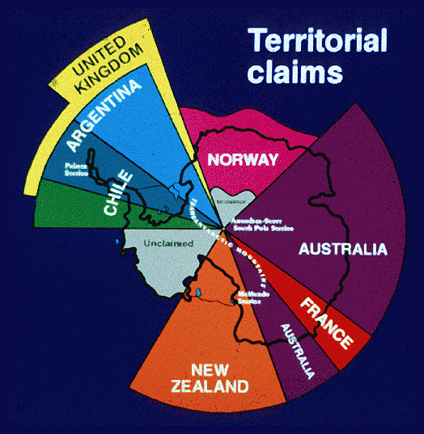
The administrative divisions are Tierra del Fuego of Argentina & Magallenas (Chilean Antarctic Province) of Chile. Since they both have disputed and overlapping claims to the Antarctic region, they attempted to assert their sovereignty in unique ways – Argentina by having the first birth on the territory, and Chile by having both conception and birth on the territory. The dispute continues to this day.
3

Slide 16
Mahatma Gandhi was not a sports fan. But in 1940, in the face of the Muslim League’s demands for a separate nation, and to call for inclusive nationalism, he said publicly: “I should have thought that such unsportsmanlike divisions would be considered taboo in sporting language and sporting manners." Despite support from prominent Congress sympathizers like the broadcaster AFS Talyarkhan, his pleas appeared to fall mostly on deaf ears. What was he advocating for? (5) Gandhi’s stance was also supported by unlikely allies: a consortium of princes led by the Maharajkumar of Vizianagaram, whose reasons were not altruistic. Having funded a competing endeavour a decade earlier that was receiving no attention from the public, they were desperate to boost its popularity. What was this competing interest? (5)
4

Slide 17
Answer is…

Slide 18
Abolition of the Bombay Pentangular The Ranji Trophy
4

Slide 19
In old British law, the owner of a plot of land had legal rights to all metals and minerals in the sub-soil, with the exception of two metals that remained Crown property. Officially, these metals were considered the most excellent things in the soil, so they could only be rightfully possessed by the most excellent person (i.e. King/Queen). However, it is likely that the restriction on the metals was put in place to assert the political power of the Crown and prevent acts of treason. What metals & what would be the treasonous acts? (5) In old Spanish & French law, the landowner’s rights did not extend to the sub-soil – all subsoil minerals & metals belonged to the King. Private citizens, however, were issued permits to excavate the land for metals – in exchange, they had to provide the King a share of the value of the dig. This practice reflects the etymological origin for what current day English word? (5)
5

Slide 20
Answer is…

Slide 21
The metals are gold & silver, and the treasonous use was coining of money The word in question is royalty (derived from French roialte) – which is today used in the context of patents, copyright and other intellectual property laws
5

Slide 22
In the 1930s, German interest in rockets & space grew significantly, with the Verein für Raumschiffahrt (Society for Space Travel) founded to harness this enthusiasm. The brief success of 1930s German rocket development, however, perhaps owed more to the novelty of the technology, enabling VfR to exploit a legal loophole that enabled it attract scientists such as Wernher von Braun, and funding that was redirected from conventional defense R&D. What loophole did Germany exploit? (5) An idiom used in German to describe people like von Braun, who were Nazi sympathizers but exonerated by Allied de-Nazification efforts for different reasons, is Persilschein. The term originated in the German army, to reflect how all new recruits would invariably bring the same empty box on their first day, which they would use to send their civilian clothes back home. After the war, it took on this new, more literal meaning. What is the etymology of Persilschein? (5)
6

Slide 23
Answer is…

Slide 24
Because of their novelty, rockets were not mentioned in the Treaty of Versailles – which limited the size of the German weapons arsenal (tanks, guns) and army. Persilschein means Persil ticket (Persil being the famous German detergent). It was a reference to how the reputation of former Nazi collaborators was laundered in the aftermath of WWII.
6

Slide 25
In calculus of variations, ‘isoperimetric problems’ involve solving questions like: what figure encloses the max area (volume) for a given perimeter (surface area)? Mathematics has a name for these problems that comes from Virgil’s Aeneid. It references the tale of a refugee who is granted ‘as much land as a bull’s hide covers’. After cutting a hide into thin strips and tracing out a large circle, hence solving the corresponding isoperimetric problem, the figure establishes a capital with a citadel whose name translates to ‘oxhide’. Who or where? (5) A similar tale features in Ferdowsi’s Shahnameh, in how prince Siyavush, challenged to build a citadel that ‘fits in the skin of a bull’ to win his love, establishes his capital. However, its name likely stems from a Sanskrit word for temple or monastery, suggesting more legend than history here. Amusingly, it also lends its name to the word used for a fruit in a familiar language. Where? (5)
7

Slide 26
Answer is…

Slide 27
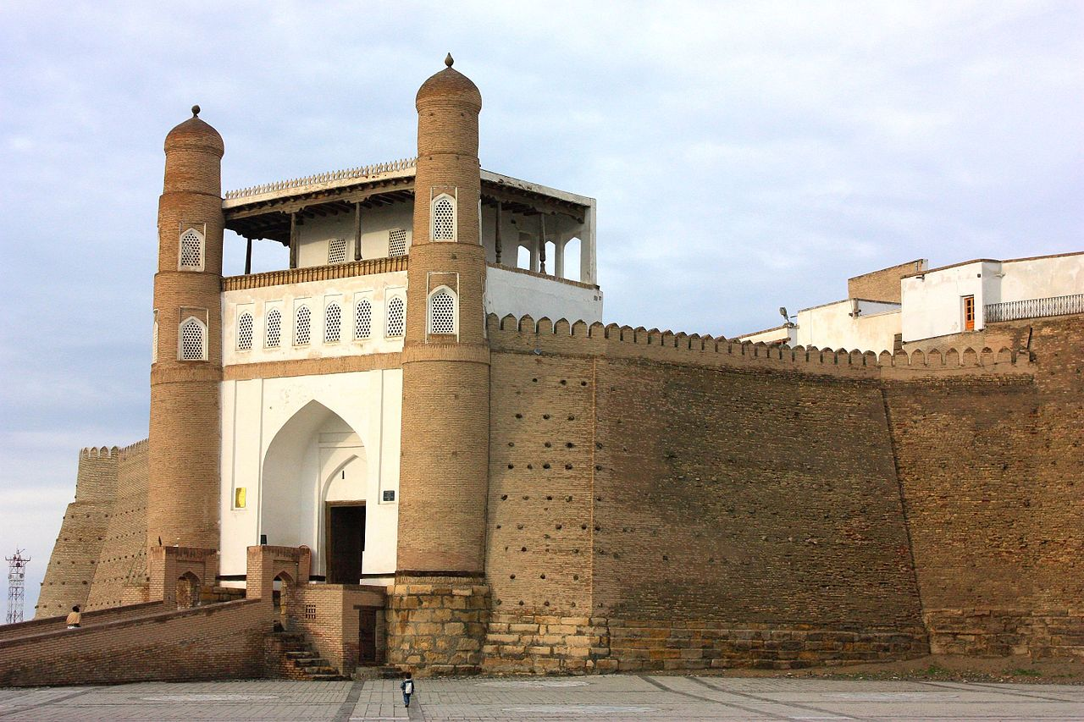
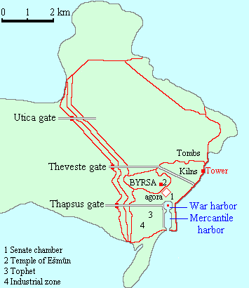
Dido, who is the founder of Carthage (the citadel is Byrsa, meaning Oxhide in Greek). This class of problems in mathematics is called Dido’s problems. Shahnameh tells the tale of the creation of the Ark of Bukhara. According to a number of scholars based on the information of Juwaini, the name dates back to the Sanskrit "Vihara" (Buddhist monastery). The fruit in question is the plum (Hindi name alubukhara).
7

Slide 28
An apocryphal, but fairly representative, story behind the founding of one African nation involves the British trying to reach Timbuktu to horde its riches. They sent a warship up a river, shooting cannonballs into enemy French territory on both banks, then claimed the land that fell within range for the crown. Which country? (5) Negotiations over this land continued at the Peace of Paris of 1783 (which ended the American Revolutionary War), where France conceded it to Britain. In exchange, the French received a Caribbean island, whose name comes from a Spanish corruption of the indigenous Taino word used to describe the rolls smoked by the inhabitants of the Greater Antilles. The island’s shape was thought to resemble these rolls. What island? (5)
8

Slide 29
Answer is…

Slide 30
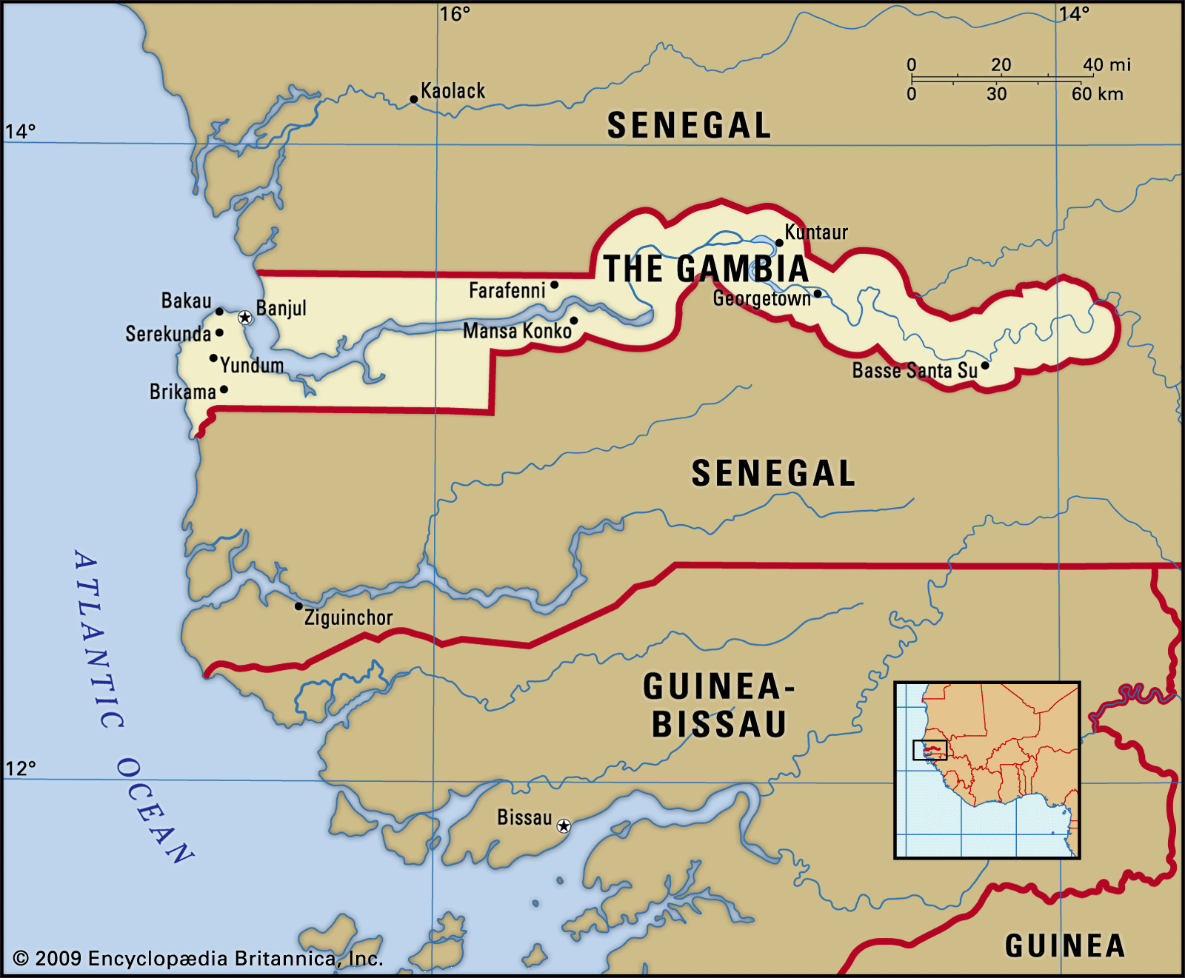
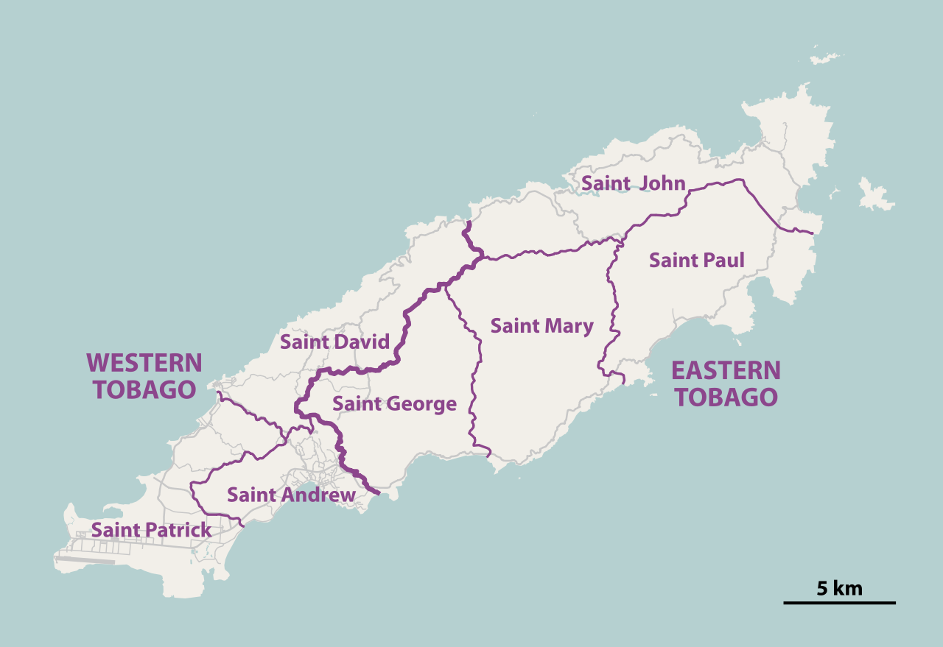
The country is the Gambia – the cannonball story is popular lore for its odd shape The Caribbean island is Tobago (from the Spanish word Tabaco).
8

Slide 31
In 1944, with canals frozen, Nazi Germany cut off the food supply lines to the Hague, leading to a winter of hunger. To keep patients from starving, pediatrician Willem Karel Dicke had to feed them anything available, such as tulip bulbs. These conditions worsened most patients’ health, but one group suffered less than expected, and even showed signs of improvement. While Dicke did not know the cause of this group’s suffering, science at the time showed it was present across rich & poor and not caused by bacteria. However, during this period, the mortality rate for this group fell from 35% to almost zero. At the end of WW II, as normalcy returned to the Hague, the mortality rate for this group climbed up again. These observations led him to a hypothesis for the cause of this group’s suffering, which formed the basis for a life-saving medical discovery. Who was the group of patients, and what did Dicke discover? (10)
9

Slide 32
Answer is…

Slide 33
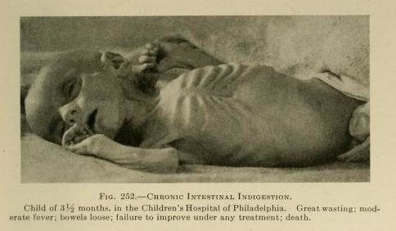
The group was children who were suffering from coeliac’s disease. At the time, it was not known that it was a genetic autoimmune disorder caused by gluten. As a result, it often a death sentence. Children with advanced celiac disease had horrifying symptoms: rashes, withered limbs, and large swollen bellies, like famine victims. Because of the disruption to food supply lines, wheat products (like bread), were no longer available, and for coeliac children, the shortage of food was less severe than the toxic effects of wheat products. When Nazi Germany fell, the Allies began to airdrop food, and coeliac patients had a negative reaction to food with gluten.
9

Slide 34

Along the border between Uzbekistan & Kazakhstan lies one of the world’s youngest deserts, once the site of the world’s 4th largest inland body of water. The water body was fed by the Amu Darya & Syr Darya rivers, before their diversion by the U.S.S.R. Per one theory, it shares an etymological root with a mountain range in the region, originating from Turkic words for “chain.” ID the water body or desert (5) Desertification of the sea has caused severe dust storms, with some particles making it as far as the Nordics. With inhospitable conditions ruling out site visits, satellite imaging is the only way to study the intensity storms. This method is used to elsewhere, such as for dust storms originating from the Sahara. However, satellite imaging is much less effective here – one scientist likened it to “trying to take a picture of a polar bear in a snowstorm”. A main factor for the ineffectiveness is the topography of this desert’s surrounding area vis-à-vis the Sahara’s. Why is satellite imaging less effective at studying dust storms originating here vis-à-vis Sahara? (5)
10

Slide 35
Answer is…

Slide 36
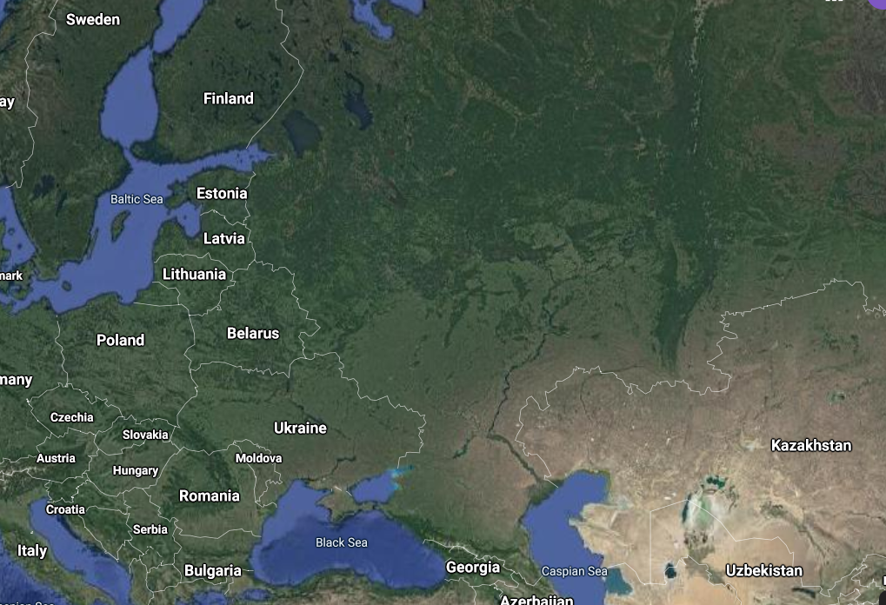

The Aral Sea / Aralkum Desert. The mountain range is the Ural mountains When dust storms rage elsewhere on Earth—like in the Sahara Desert—they eventually blow out over the dark ocean, making them easy to see on satellite images. But in the landlocked Aralkum, the contrast between the surface and airborne dust is minimal, which explains why they can travel long distances with imperfect detection
10

Slide 37
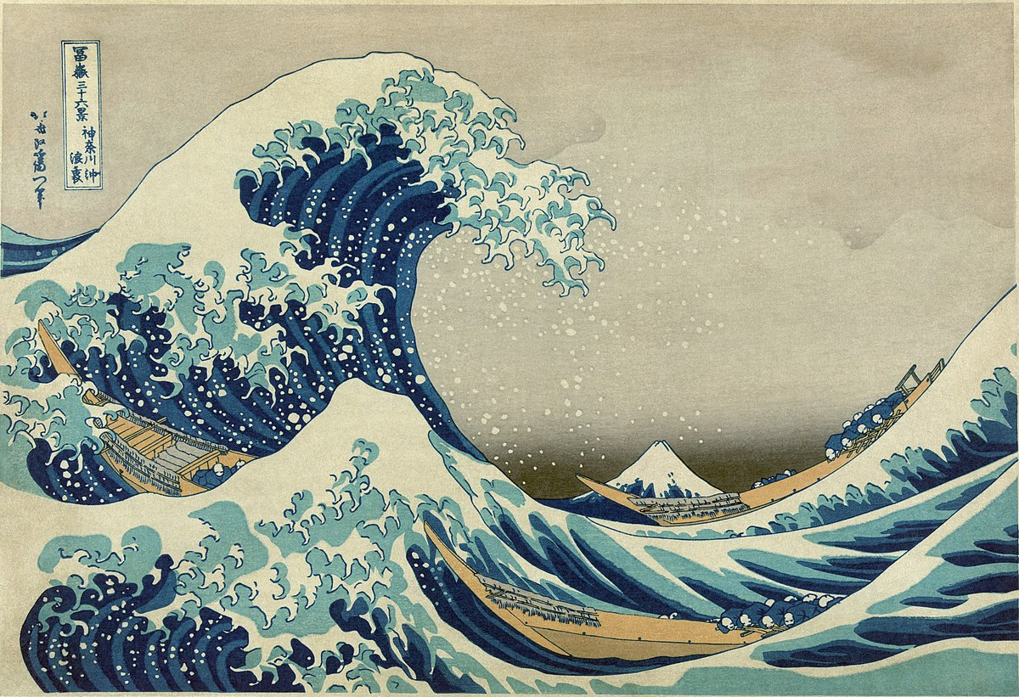
As Japan opened to global trade in the 1830s, ukiyo-e prints became wildly popular across Europe. Ironically, this was due to their use of Prussian blue: despite being invented in Berlin in 1705, it was perceived as exotic. After viewing a print of The Great Wave, one artist wrote in a correspondence: “these waves are claws, the boat is caught in them, you can feel it.” It likely inspired a future work that is usually seen as a hallucinatory creation. What work? (5) Recognizing the pigment’s appeal, merchants from East Asia began exporting a new version of an older product, by adding 0.5 lb of roasted Prussian blue and gypsum per 100 lb of product prepared. This captured unwitting tastes abroad until 1897, when US legislation, in a precursor to a larger effort a decade later, made the practice unprofitable. What was the new product? (5)
11

Slide 38
11

Slide 39
Answer is…

Slide 40

The Great Wave inspired Starry Night by Vincent van Gogh (1899)
11

Slide 41
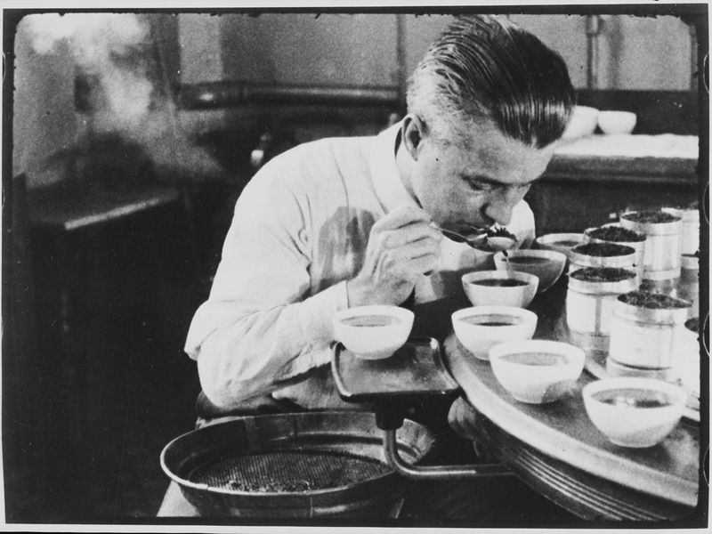
Green tea was the export – Europeans and Americans were enamored by the color, and consumed green tea in large quantities, until the U.S. passed the Tea Importation Act of 1897 to control toxicity and adulteration. Later, in 1905, the Food and Drugs Administration (FDA) was created, and tea testing (image) fell under their purview till 1999.
11

Slide 42
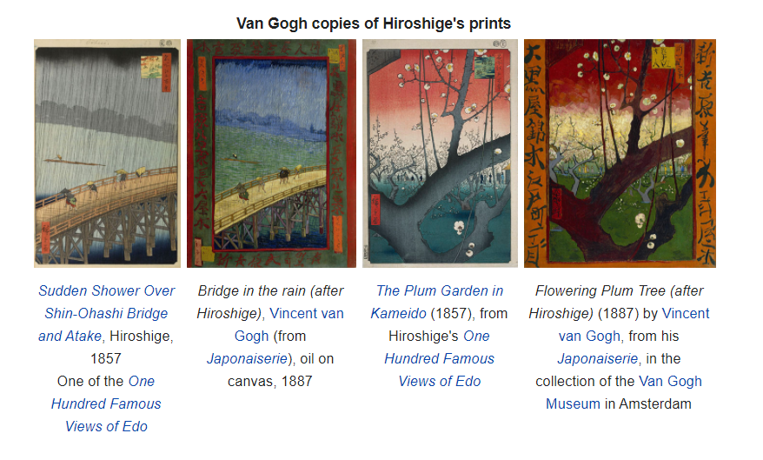
Bonus trivia: Van Gogh copies of Hiroshige prints
11

Slide 43
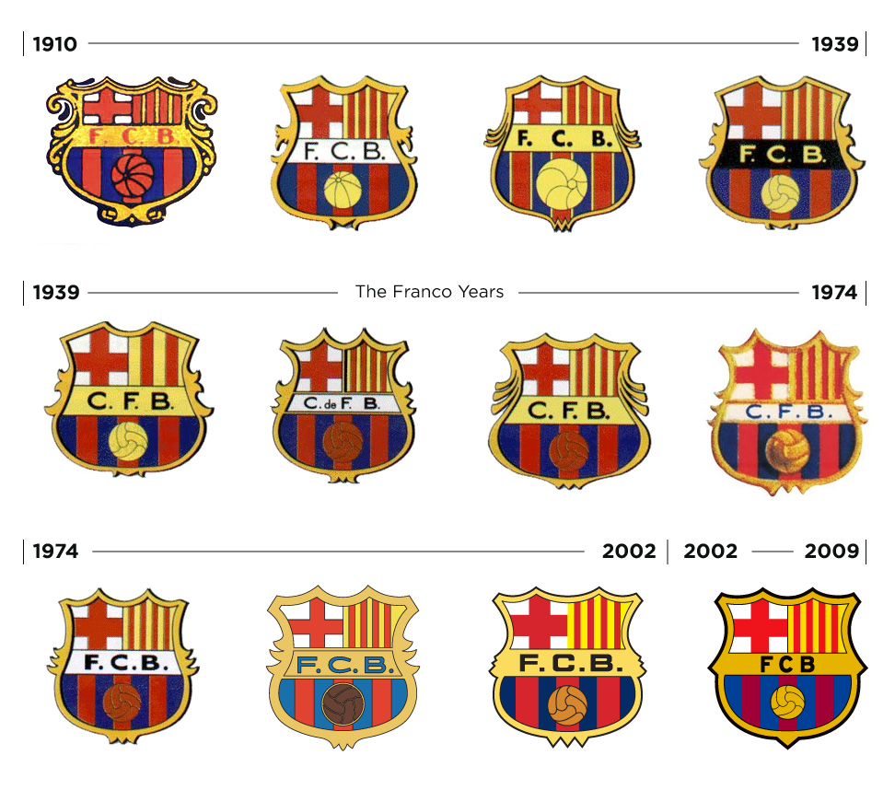
In 1939, after his success in the Civil War, General Franco was keen to promote Spanish nationalism, at the expense of regional culture, as part of a homogenizing campaign in favor of Castilianism. FC Barcelona was one his prominent targets, and so he ordered two changes to be made to the club’s crest to reflect this nationalist mission. What two changes did Franco order, and why? (10)
12
Pre-Franco
Franco

Slide 44
Answer is…

Slide 45

Franco first ordered the club’s name to be changed from FCB, or Futbol Club Barcelona (the Catalan name) to CFB, or Club de Futbol de Barcelona (in Spanish). Franco also ordered the reworking of the top right hand corner of the badge, so that it did not resemble a Catalan flag, but retained the red and yellow colors which signified Spain.
12

Slide 46
In 1948, Clement Attlee pushed India to include a certain constitutional provision. He viewed this provision as well aligned with India’s historic legacy of empires and pitched his proposal as universal in nature, transcending creeds and races. The INC was opposed to this idea, fearing it compromised India’s commitment to non-alignment. Nehru, however, eventually acceded to a modified version of the request, although it was not constitutionalized. What did Attlee want India to do? (5) While India considered Attlee’s request, there were consequences in the sporting world. At the 1947 ICC Conference, the question of India’s status was raised. The ICC, wishing to stay true to roots, changed India’s status to provisional, and did not list any visits to or from India in the cricket calendar. This position was reversed, and India was re-admitted as a full member with Nehru’s actions in 1950. Why did the ICC change India’s status? (5)
13

Slide 47
Answer is…

Slide 48
Attlee wanted a role for the British King (likely as a nominal head of state) in the Indian Constitution. The Indian Constitution did not carve out such a role, but Nehru joined the Commonwealth of Nations in 1950. The ICC used to stand for the Imperial Cricket Conference, since cricket was only to be played by Britain, its colonies and countries that were dominion to the British Crown. With uncertainty over India joining the Commonwealth or creating a constitutional role for the King, the ICC chose not to include them to stay true to their roots.
13

Slide 49
Anti-Clockwise

Slide 50
At Mexico 1986, Argentina’s kit was designed by Le Coq Sportif. Apart from the colors, there was one important design difference between the home and away kits. Playing in their away strip for the first time in the R16 v. Uruguay, Argentina held on for a 1-0 win. Coach Carlos Bilardo found his players more tired and less mobile than usual after that game and pinned the blame on Le Coq’s kit. Deciding that his players could not play in that strip again, Bilardo set off on a hunt across Mexico for a similarly colored Le Coq strip, fortuitously finding some in a store run by his 3rd choice GK. An unnamed designer sketched out the Argentina badge on his computer, which explains its crude shape and the lack of stars. Finally, shiny grey numbers used for NFL teams was stitched onto the backs. While most players were nonplussed, Maradona loved the jerseys and said “We will beat the English with this.” Why did Argentina seek a replacement kit? (10)
14

Slide 51


14

Slide 52
Answer is…

Slide 53
Le Coq made the home kit using a revolutionary 'bee hive' technology that permitted air to circulate through the fabric. The nation's secondary blue jersey, however, was a more traditional cotton design. Because of the heat and humidity in Mexico, the Argentine players were drenched at the end of the match. The Argentine kit man even joked that when they looked for scales, “I am exaggerating, but they weighed something like ten kilos more.”
14

Slide 54
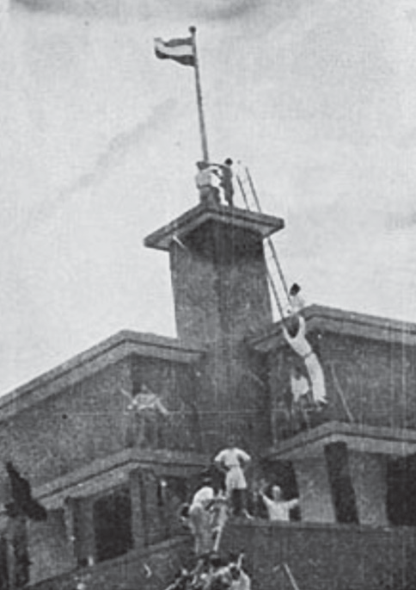
Ahead of the Battle of Surabaya in 1945, the city’s Hotel Yamato served as the headquarters for the Recovery of Allied Prisoners of War association. On September 19, group of recently released Allied troops climbed to the rooftop of the hotel and engaged in a pointed display of patriotism. A group of Indonesians then responded with a gesture that visually, and very starkly, symbolized the desire for independence from colonial rule. Photographs from the incident made their way across the nation and marked the beginning of the Indonesian War of Independence for many. Surabaya continues to commemorate this event annually, at the hotel now called the Hotel Majahapit. How did the crowd respond to the Allied troops’ actions? (10)
15

Slide 55
Answer is…

Slide 56
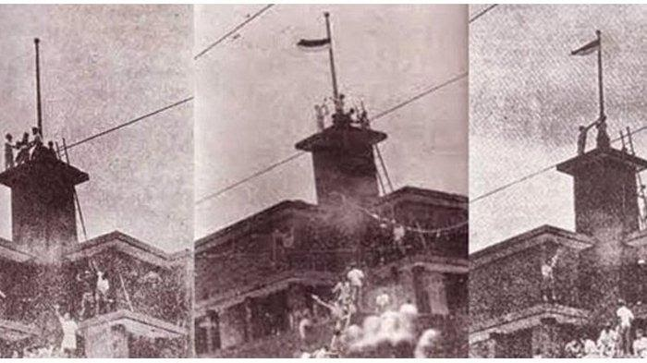
Dutch soldiers recently released from captivity enthusiastically raised the Dutch flag atop the hotel. In response, as a stand against Dutch colonialism, Indonesians climbed the hotel, lowered the Dutch flag, tore off the blue third of the flag, and re-raised it as an Indonesian flag.
15

Slide 57
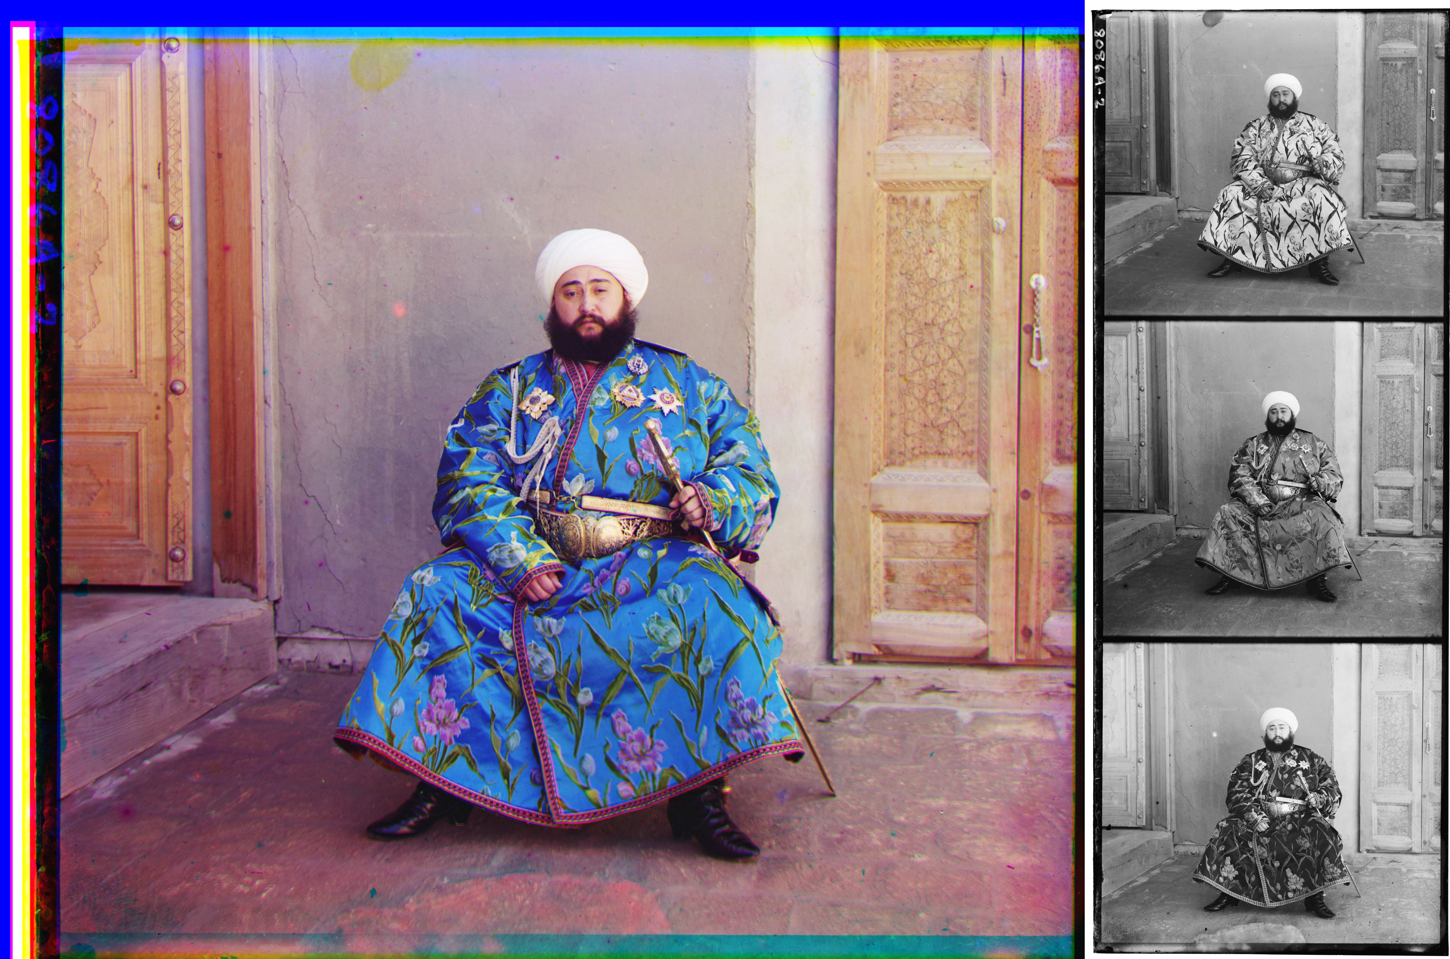
These photographs of Muhammed Alim Khan were taken in 1911 by Russian chemist and photographer Sergey Prokudin-Gorskii. He pioneered a method introduced by James Clark Maxwell in the 1850s, inspired by how the human body functioned. A certain effect could be achieved by taking three separate black & white photographs under specific settings, The negatives of the photos would then be superimposed and combined, leading to the desired effect. Due to the labor intensive nature of this process, Prokudin-Gorksii only produced ~ 100 such photos. How did Prokudin-Gorskii take the three photos, and what effect was he trying to achieve? (10)
16

Slide 58
Answer is…

Slide 59

Prokudun-Gorskii wanted to take color photographs. As an imitation of the way a normal human eye senses color, the visible spectrum of colors was divided into three channels of information: black and white photos taken through a red, green and blue filter respectively. The resulting three photographs could be projected through filters of the same colors and exactly superimposed to create a color photograph effect
16

Slide 60
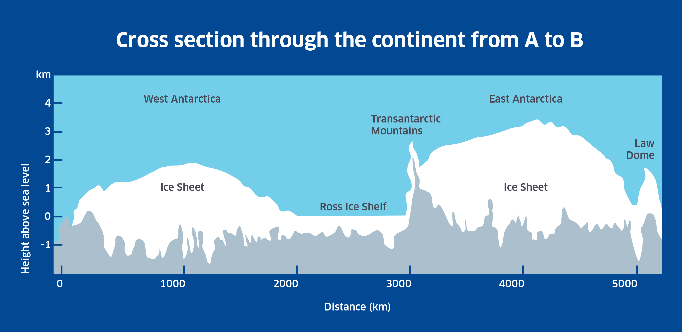
Ross Ice Shelf is named in honor of James Clark Ross, who led a scientific exploration of Antarctica from 1839-1843. For the expedition, he captained an unusually strong warship, which was equipped to fire heavy mortar at high angles and withstand the recoil. Upon sailing past the Ice Shelf, Ross witnessed a natural phenomenon that perhaps reminded him of this power, leading him to name what he saw after his ship. What did Ross witness, and how did he pay tribute to his ship? (5) There is a notable difference between the land structure of the Western and Eastern Antarctic Ice Sheets. As a result of this difference, the West Ice Sheet serves as an important indicator of global warming, while the East Ice Sheet cannot. Why is the West Ice Sheet able to play this role while the East is unable to? (5)
17

Slide 61
17

Slide 62
Answer is…

Slide 63

Ross’ expedition saw the eruption of Mount Erebus – the volcano which is the second most elevated point in Antarctica. He named it after the warship HMS Erebus. (Another Antarctic volcano, Mount Terror, was named after the other warship, HMS Terror). As the image shows, a large portion of the West Antarctic Ice Sheet is submerged underwater, while most of the East Antactic Ice Sheet is above sea level. As a result of global warming, the biggest threat to the Antarctic Ice Sheet is warmer ocean waters, which can cause the Ice Sheet to melt. Because so much of the West Antarctic Ice Sheet is submerged, it is easier for water to undermine it, kickstarting a faster collapse.
17

Slide 64
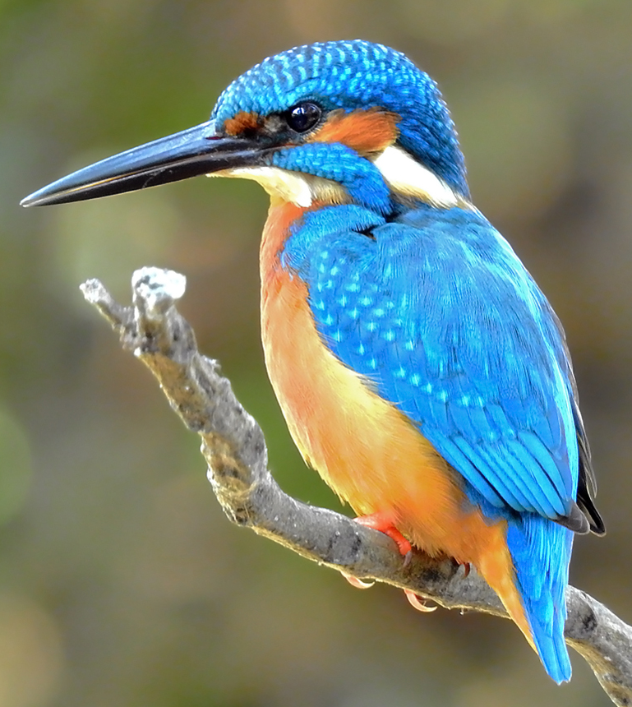
Eiji Nakatsu, who led the Technical Development Dept. of X, was a birdwatching enthusiast. In 1997, as part of his job, he was tasked with redesigning something to make it more efficient and reduce the disruption it was causing to residential areas. In finding a solution, Nakatsu developed a design inspired by the common kingfisher, which allowed it to catch prey without making a splash in the water. He shaped different prototypes and shot them down pipes, and results showed the Kingfisher-inspired design was the best for the purpose. When Nakatsu applied it to his task, the resulting design eliminated the cause of the disruption, while also reducing electricity use by 50%. What problem was Nakatsu trying to solve, and how did the Kingfisher play a role in the solution? (10)
18

Slide 65
Answer is…

Slide 66

Nakatsu worked for the Japan Railways team in-charge of design of the Shinkansen (bullet train). The old bullet trains – because of their design – used to create loud sonic booms whenever they passed through tunnels. Nakatsu re-designed the bullet trains to look like a kingfisher’s beak – which helped eliminate this problem.
18

Slide 67
In the late 1700s, Luigi Galvani found frogs’ legs twitched if electricity was applied to them. He believed that the electricity came from within the animal itself. His nephew, Giovanni Aldini, tried to demonstrate this by applying current to a recently executed murderer. The results were shocking and spread through Europe, eventually reaching X, who was vacationing in Switzerland at the time. The experiment in turn inspired X’s magnum opus. ID X and the magnum opus. (5) In 1931, 8-year old Earl Bakken was inspired to be an engineer by an adaptation of X’s magnum opus. Adult Bakken was approached by surgeon Walt Lillehei, who was frustrated that blackouts during surgery led to infants with blue baby syndrome dying in the O.T. The best tech at the time was heavy and needed to be always plugged into mains, making it immovable. Lillehei also wanted a round-the-clock solution. What did Bakken invent as a solution? (5)
19

Slide 68
Answer is…

Slide 69
In Aldini’s experiment, on the first application of the process to the face, the jaws of the decreased criminal began to quiver and the adjoining muscles were horribly contorted and one eye was actually opened. In the subsequent part of the process, the right hand was raised and clenched and the legs and thighs were set in motion. This experiment is thought to have inspired some of the ghost stories told by 19 year old Mary Godwin (later Mary Shelley) on her Swiss vacation, which later led to Frankenstein. Bakken invented the pacemaker; he relied on recent developments in transistors, allowing him to create the world's first wearable pacemaker. Bakken was also the founder of medical devices MNC Medtronic.
19

Slide 70
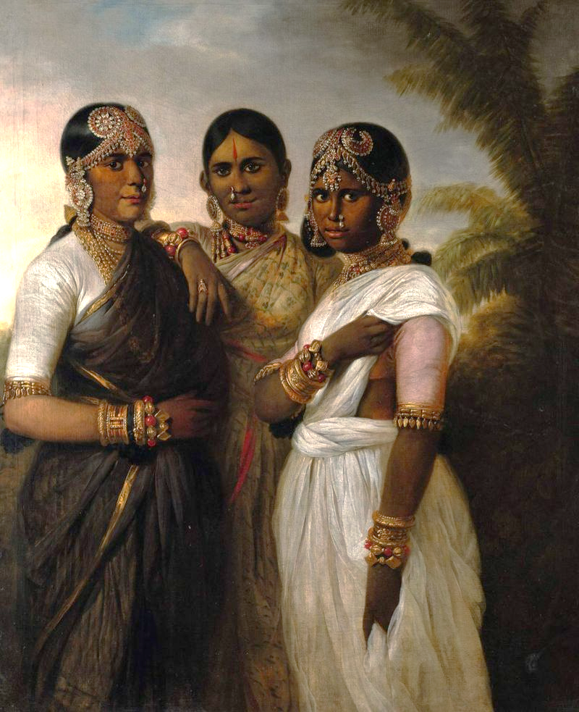
Following Tipu Sultan’s death in the Siege of Seringapatam in 1799, the EIC installed 5-year old Krishnaraja Wodeyar III on the Mysore throne. However, the EIC’s ambitions were hampered by its inability to protect British lives from a threat that was proving difficult to address regionally. This was largely because prevailing norms on caste and racial bodily purity were violated in the process of procuring a solution from abroad. The endeavour was hence unpalatable to the local public, making the EIC’s political position tenuous. To overcome public perceptions, the young Wodeyar’s grandmother allowed the British to create this portrait in 1806, which likely features the grandmother herself sandwiched between the king’s wives. What threat did the picture help EIC address, eventually winning them support? (5) Why was the solution to the threat originally seen as violating local social norms? (5)
20

Slide 71
20

Slide 72
Answer is…

Slide 73
The threat was smallpox, and the solution was the smallpox vaccine. The Queen on the left of the painting is believed to have suffered from smallpox, as indicated by the coloration on her face. The Queen on the right of the painting is thought to be indicating to where she got the jab. Vaccines were transported by arm-to-arm human chains: one person was injected with the cowpox vaccine, and their lymph was harvested and injected into another person. This challenged Indian norms of bodily purity.
20

Slide 74

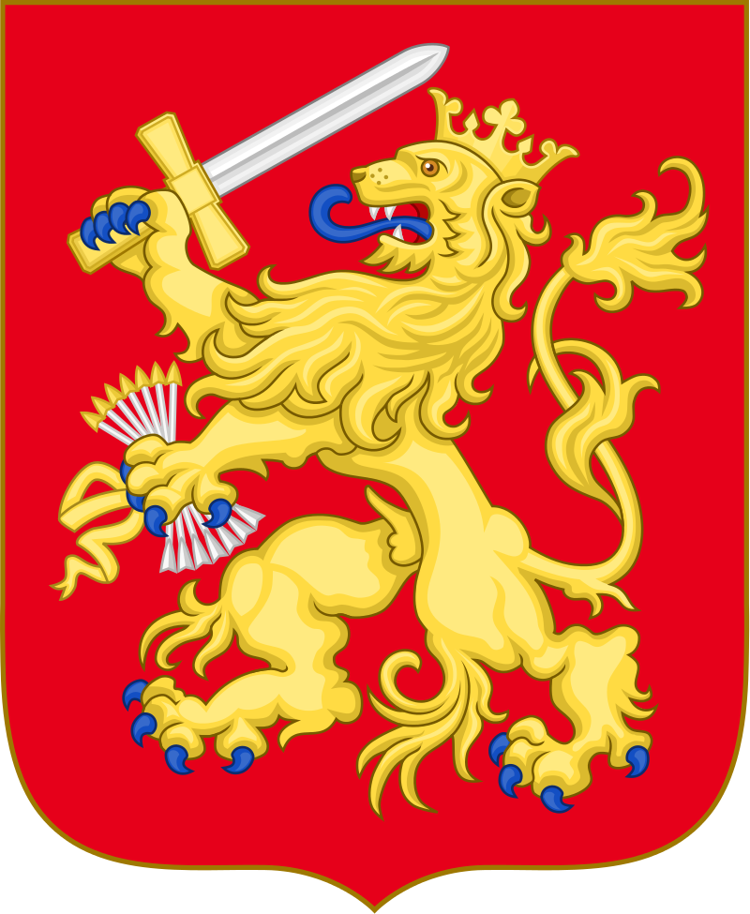
The first inclusion of arrows on the Seal of the U.S. was in the 1770s, thought to be inspired by the precursor to the current Coat of Arms of a European nation. The arrows symbolized the impact of the Act of Abjuration (1581), but this symbolism was also apt for the politics of America’s independence struggle. Which European nation, and what did the arrows symbolize? (5) In 1945, Harry Truman signed an Executive Order that defined the Presidential Seal and Coat of Arms for the first time. As part of this Order, he made one aesthetic change (reflected in image) to conform to heraldic traditions of honor. Truman, however, also liked this change since he felt it more appropriately reflected the nation’s aspiration and priorities. This decision has also led to many incorrect theories in film & TV pertaining to the design of the U.S. seal. What did Truman change? (5)
21

Slide 75
21

Slide 76
Answer is…

Slide 77
X = Netherlands (then known as the Dutch Republic or the Republic of the Seven United Netherlands). The seven arrows represented the seven Dutch provinces united together to rebel against the rule of King Philip II of Spain in the 1580s, much like the 13 colonies of the U.S. would do ~ 200 years later. Truman turned the face of the eagle – it went from facing the arrows, to facing the olive branches – to reflect the heraldic tradition of facing right. Truman felt this was symbolic of a nation dedicated to peace after WWII. This has led to conspiracy theories that the head of the eagle faces the arrows when the U.S. is at war and the olive branches in peacetime.
21

Slide 78
Pisupo Lua Afe, made entirely from corned beef cans, seeks to highlight the public health impact in Samoa of canned food, which have led to high obesity rates owing to the levels of sodium & saturated fat. The work references Samoan linguistic history – the first canned food introduced to Samoa in the 1960s was tins of X. Since Samoans had no prior exposure to canned food, the term adopted for it in the local dialect was a corruption of X, with slight adjustment in accordance with Samoan linguistic conventions. ID X, and what is the Samoan linguistic convention (5)? Samoa’s public health crisis comes amidst changing a geopolitical climate. In 2011, it made a momentous decision to re-align itself away from the U.S., with whom it shared a long economic history, stretching back to the arrival of U.S. whalers in the 1800s. However, Samoa’s decision would see closer alignment with Australia & N.Z., who were closer partners in a new economic era. This decision had important implications for December 30 that year in Samoa. What did Samoa do? (5)
22

Slide 79
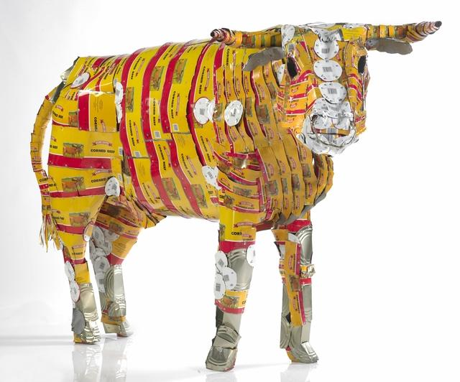
22

Slide 80
Answer is…

Slide 81
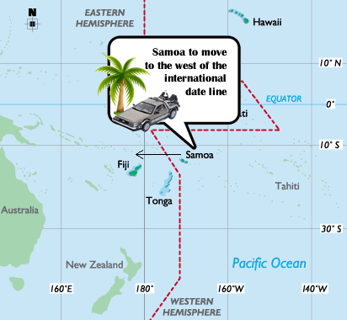
The first canned food was Pea Soup, and the Samoan linguistic tradition is to end words in vowels, giving the term Pisupo – referenced in the title. Samoa adjusted its time zone, moving from UTC -11 to UTC + 13 : as a result, the whole day of December 30, 2011 was skipped.
22

Slide 82
Qian Xuesen could claim to have put two nations on the moon: after seminal work in the U.S. Forced to leave the U.S. in the Red Scare, he became China’s ‘Rocket Man’. At Caltech in the 1930s, he worked on rocket motor design with other pioneers like Theodore von Karman & Frank Malina (later founders of JPL). Their work was considered frivolous and highly dangerous: it involved explosive chemicals and saw many failures. This earned them a name later adopted by the RAF Dambusters and then popularized through comic books (and later movies). What? (5) Qian’s life was captured in a biography titled The Thread of the _______ by Iris Chang (famous for her work on Nanking). The title references the NATO reporting name for the missiles he developed at the Institute of Mechanics in Beijing, which he founded in 1956. Ironically, these very missiles were used by Iraq against American warships during the Gulf War in 1991. What missile? (5)
23

Slide 83
Answer is…

Slide 84
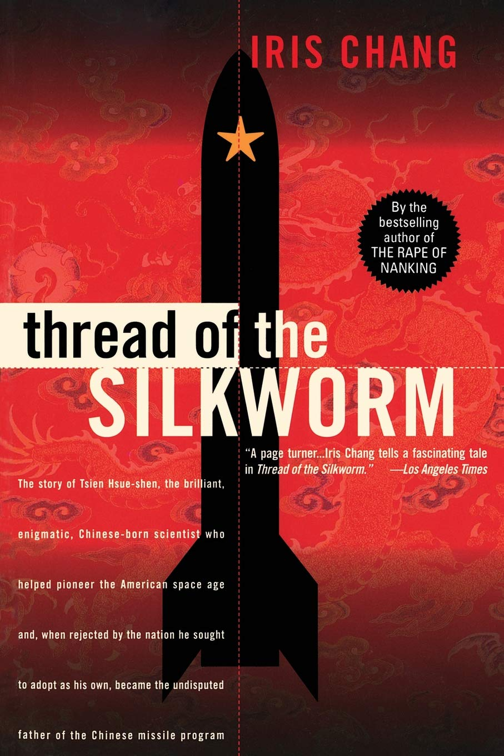
The group was nicknamed The Suicide Squad. Silkworm
23

Slide 85
In 1959, the RBI was facing rapid depletion of India’s foreign reserves, since INR in British protectorates was freely convertible with Sterling. To address this, the RBI issued special notes for use by Indian citizens only on certain annual travels to a destination that was not a British protectorate itself but neighbored many. These new notes were not legal tender in India, but banks in the destination could convert them (but not INR) to Sterling with the RBI. New notes in the series all had serial number beginning in HA & were only payable in Bombay, where these citizens departed from. Which Indian citizens were given these notes? (5) These special notes were only in circulation for ~ 1 year, before a monetary policy change in the region eased concerns over depleting reserves. This change was also implemented by the RBI in 1959 in the region’s British protectorates. Coupled with cessation of INR-Sterling conversion in the Protectorates, it eliminated concerns over illicit removal of INR overseas. What was the change the RBI introduced? (5)
24

Slide 86
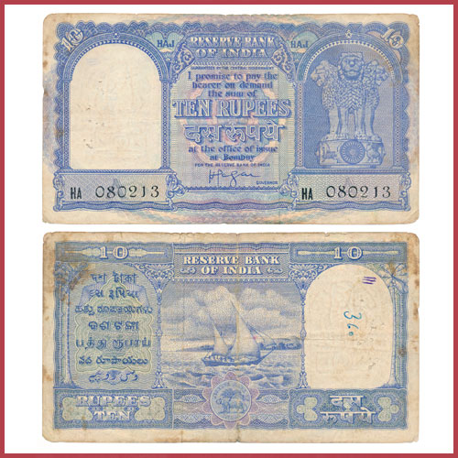
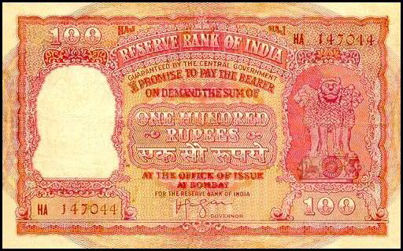
24

Slide 87
Answer is…

Slide 88
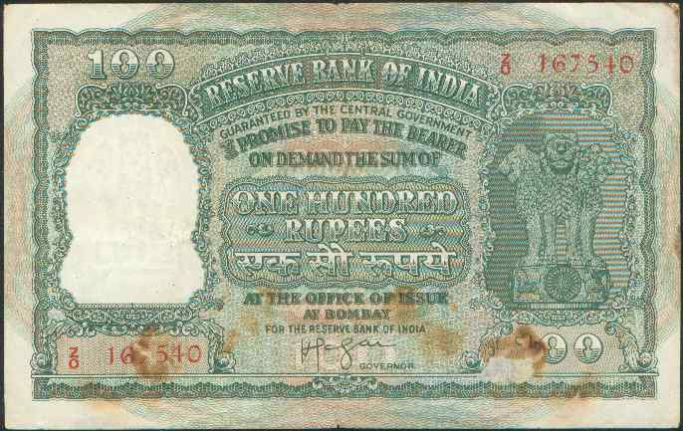
These were Indian citizens who were going to Saudi Arabia for the Haj. The new rupee note – the Haj rupee – was exclusively issued to Haj pilgrims for use in Saudi Arabia. The monetary policy change made at the same time was the creation of the Gulf Rupee, which replaced INR as the currency of circulation in the British Protectorates in the Arabian Gulf. This, coupled with removal of the INR – Sterling convertibility, helped reduce illicit smuggling of INR out of India.
24

Slide 89
Penultimate Question Coming Up Score Check

Slide 90
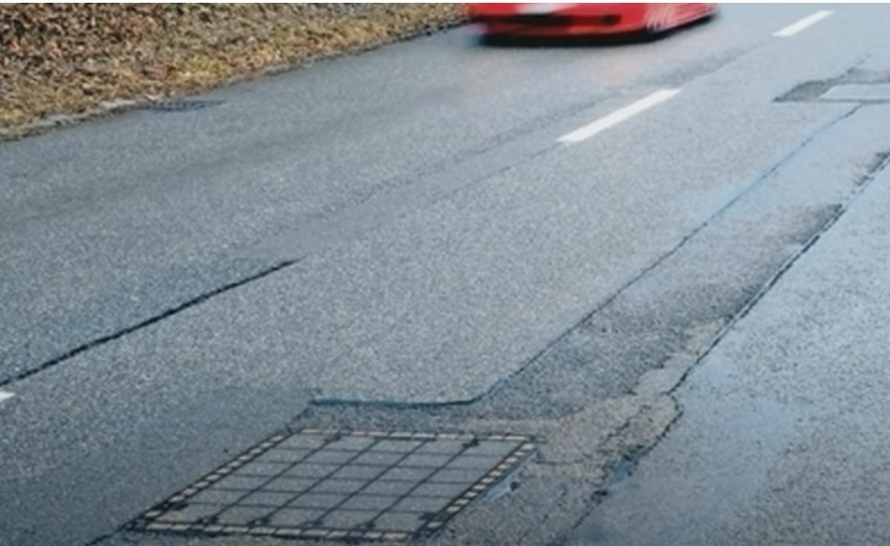
In the 1930s and 1940s, a country rejigged significant portions of its roadways, or junctions where highways crossed a railroad line, to install grates of the kind seen in the picture. Under these grates, explosives such as TNT or dynamite were packaged, capable of remote detonation. The reason for the installation was to ensure that an important foreign relations priority of the country was maintained. It was only as recently as 2014 that the last of the explosives were removed. ID the country, and what was the foreign policy priority? (5) Grates of this form were primarily installed on infrastructure close to its Northern border. Few such grates were installed in the South. Why? (5)
25

Slide 91
Answer is…

Slide 92
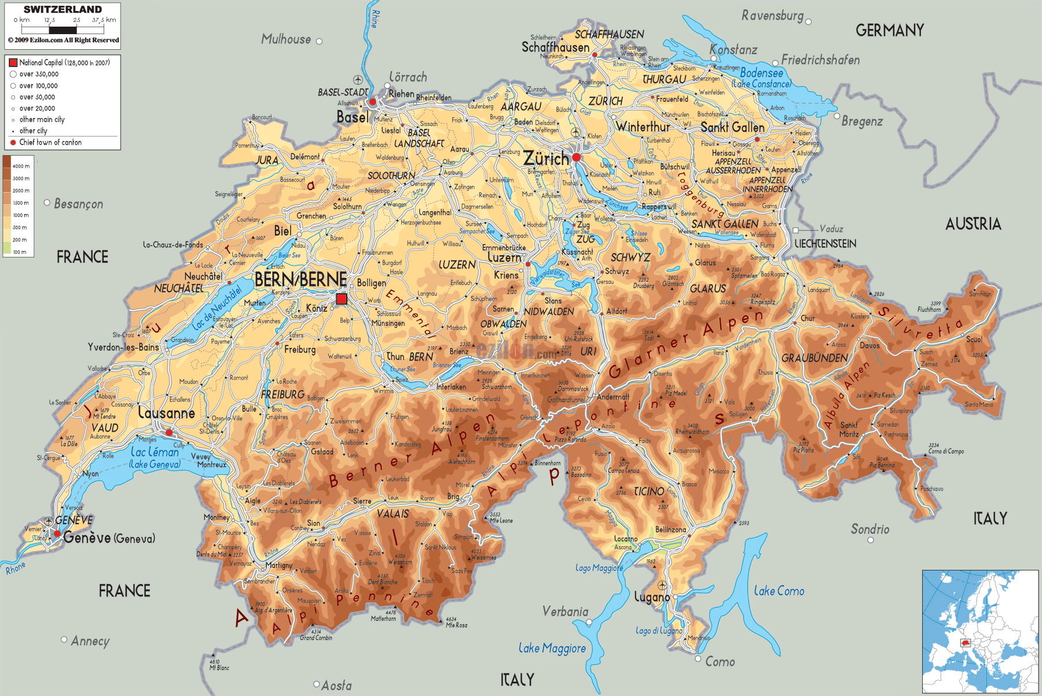
The country is Switzerland, and the foreign relations priority was to maintain their neutrality. To prevent Nazi Germany from invading Switzerland from Germany, or neighboring France which was under Nazi control, infrastructure was rigged to explode, and literally barricade Switzerland in It wasn’t necessary on the Southern border since the Alps made it difficult for anyone to enter from the South
25

Slide 93
Nearly 500,000 Atlantic horseshoe crabs (Limulus polyphemus) are harvested every year on the United States east coast for their mysterious ‘blood’ fluids. But like other invertebrates, the crabs do not have a closed circulatory system. A fluid called haemolymph circulates in their bodies instead. It contains a copper-based protein responsible for oxygen transport called haemocyanin, whose oxidation results in the fluid’s most distinctive feature. What feature? (5) The haemolymph also contains immune cells called amoebocytes, which release a compound known as Limulus Amoebocyte Lysate (LAL). LAL is ultra-sensitive to any bacterial toxin residue: at the slightest exposure to endotoxins present even after bacteria are sterilized, LAL instantly coagulates into a gel to immobilize invading pathogens. What purpose does the pharma industry predominantly use LAL for? (5)
26

Slide 94
Answer is…

Slide 95
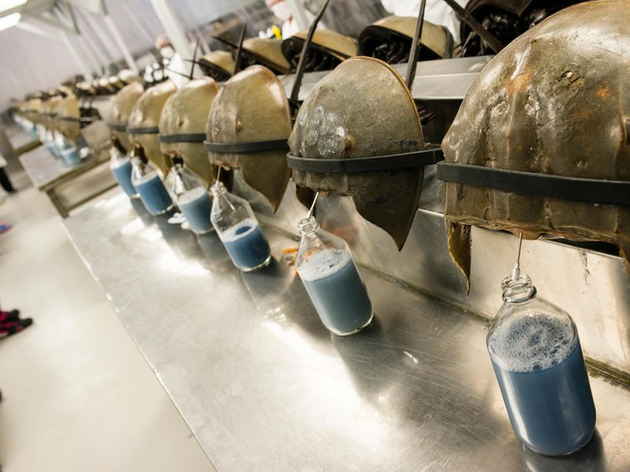
Atlantic horseshoe crabs have a blue “blood” Because of the presence of LAL, it is used to ensure the sterility of vaccines
26

Slide 96
Thank you!

Slide 97
Backups

Slide 98
Another benefit of Frau im Mond was that it boosted German interest in rockets & space, with the Verein für Raumschiffahrt (Society for Space Travel) founded by the film’s scientific advisors. The brief success of 1930s German rocket development, however, perhaps owed to the novelty of the technology, enabling it to exploit a legal loophole that enabled it attract scientists (such as von Braun) and funding from more conventional defense & space technologies. What was the loophole? (5) An idiom used in German to describe people like von Braun, who were Nazi sympathizers but exonerated by Allied de-Nazification efforts for different reasons, is Persilschein. The term originated in the German army, to reflect how all new recruits would invariably bring the same empty box on their first day, which they would use to send their civilian clothes back home. After the war, it took on this new, more literal meaning. What is the etymology of Persilschein? (5)
2

Slide 99
X traces its origins to an 1820s Boston fad that intentionally misspelt coded abbreviations, such as KC (Knuff Ced – Enough Said) or KY (Know Yuse – No Use). X became the most popular misspelt contraction, an abbreviation for a common phrase used to confirm that everything was in order. The popularity of X even prompted Martin van Buren, from Kinderhook, NY, to adopt in his flailing re-election campaign. His opponents tried to turn this against him, remarking it referred the “awful catastrophe” of his first term. ID X? (5) The popularity of X in current vernacular may also owe a debt to a certain 19th C invention.
4

Slide 100
Answer is…

Slide 101
OK The telegraph
4

Slide 102
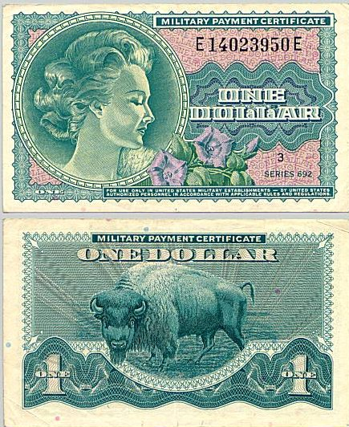

12

Slide 103
Military Payment Certificates (MPC) was used by the U.S. to pay troops stationed in foreign countries where the U.S. was engaged in post-war reconstruction efforts. MPCs were convertible to U.S. dollars upon end of the deployment, and convertible to local currencies when going on leave (but not vice versa). They were designed since the U.S. could not pay troops in local currency that it did not control. However, it did not want to pay soldiers in U.S. dollars, as it realized that dollar payments encouraged behavior that was counterproductive to long term
12

Slide 104
Answer is…

Slide 105
ABC
12

Slide 106
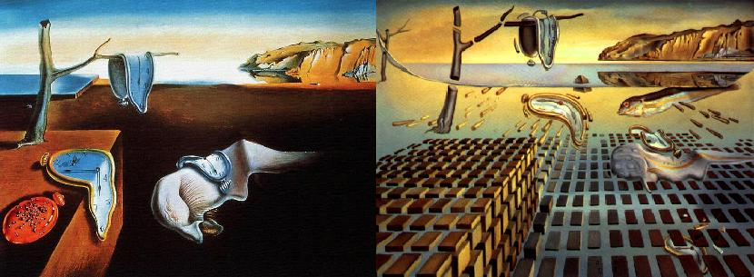
The Persistence of Memory (1931) (left) & The Disintegration of the Persistence of Memory (1954) (right) – Salvador Dali Setting: Cadaques, Spain
14

Slide 107
The Persistence of Memory was painted at the height of Dali’s Surrealist phase, which were most interested in the subconscious, and to express that which cannot always be perceived. By the time of Disintegration, Dali’s Surrealist leanings had faded, and he updated the painting to reflect his new interests. The first was Dali’s newfound interest in science, which is reflected in the foreground of the picture. In painting these distinct units, Dali again attempts to represent something that cannot be perceived and is foundational, but The second was Dali’s perspectives on politics, which is reflected in the background of the picture.
14

Slide 108
Pisupo Lua Afe (Corned Beef 2000) by Michael Tuffery
17

Slide 109
Samoan artist Michael Tuffery highlights two important issues that plague his nation with these artworks. First is the public health impact of canned food, captured in Pisupo Lua Afe, which is made entirely from cans of corned beef, which is high in sodium & saturated fat. The work references Samoan linguistic history – the first canned food introduced to Samoa in the 1960s was tins of X. Since Samoans had not been exposed to canned food previously, the word for it in the local dialect was a corruption of X, with slight adjustment in accordance with Samoan linguistic conventions. ID X. (5)
17

Slide 110
Answer is…

Slide 111
Pea soup Overfishing
17

Slide 112
X – the biggest of its kind at the time – was having challenges financing itself in 1930. Users paid steep pries ($4/mile at the time), but limited space meant this was not a sufficient revenue stream. Accordingly, X decided to recoup costs by entering a new business – the delivery of postage. Special stamps would be issued for delivery, and post with those stamps would only be delivered by X. Post offices in turn would provide 93% of the revenue to X for stamps used. ID X (5). USPS eventually participated out of goodwill, designing a set of 3 stamps worth 60 cents, $1.30 and $2.60 respectively. Secretly, they expected U.S. collectors would snap up most of the stamps, keeping them out of circulation, and ensuring that the Post Office held onto most of the money. This plan, spectacularly backfired, with only 27% of stamps bought, and most used to actually post mail. This should have, in hindsight, been obvious given X’s financial struggles. Why did the idea fail? (5)
9

Slide 113
Answer is…

Slide 114
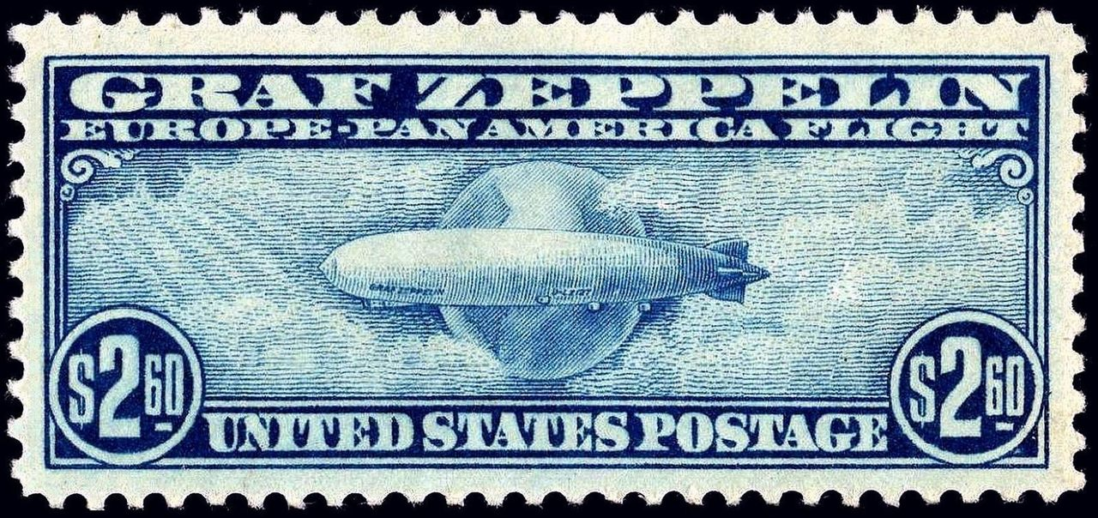
X = Graf Zeppelin, the largest Zeppelin at the time The reason for its failure was the Great Depression, which made it difficult for any of them to pay $4.55—50 times the cost of a loaf of bread—for a set of three collectible stamps. Graf Zeppelin faced similar problems with attempts to charge admission to view it on the ground didn’t go over well with the public, who were generally hurting from the Great Depression, and who wanted their close-ups for free.
9

